Slide 1

Low Voltage System
Vasilis Amoiridis
Sokratis Koseoglou

Slide 2


Low Voltage System
Presentation Chronicle
Part One
Part Two
Part Three
Part Four
Part Five

Slide 3

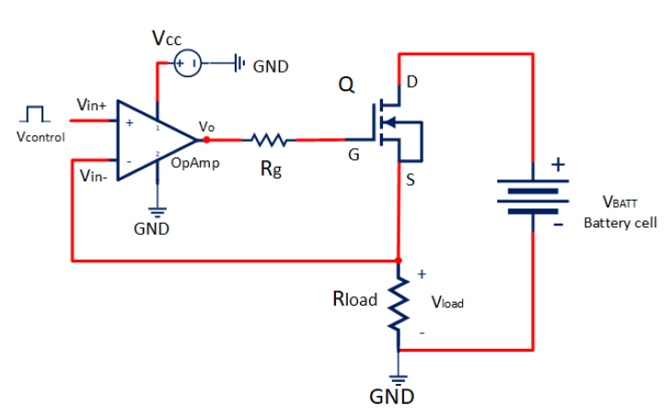
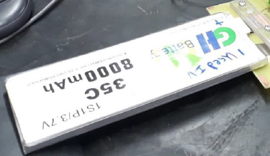
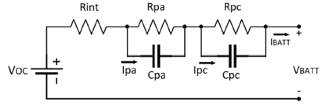
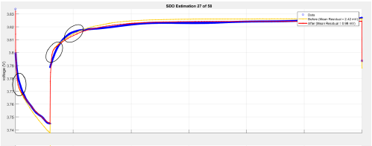

Low Voltage System
Internal Resistance PCB
VRint

Slide 4
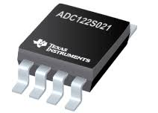
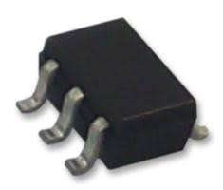
Low Voltage System
Internal Resistance PCB
ADC (Analog-to-Digital Converter)
Texas Instruments
12bit ADC
2 channels
SPI Protocol
DAC (Digital-to-Analog Converter)
Linear Technology
12bit DAC
SPI Protocol

Slide 5
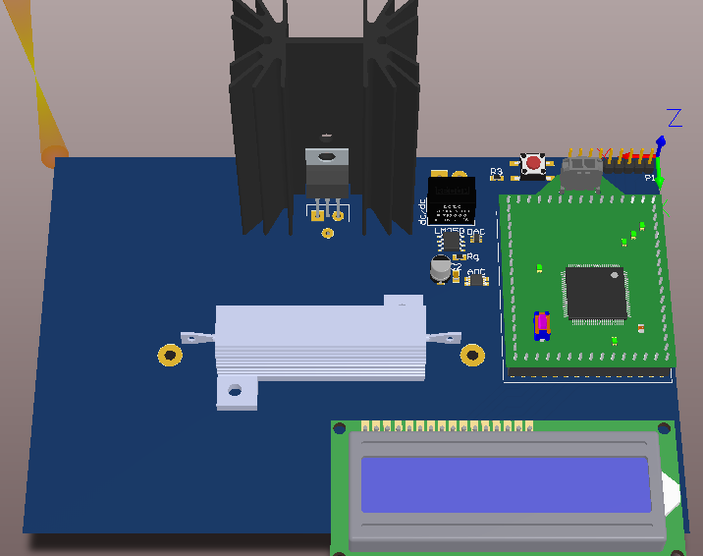
Low Voltage System
Internal Resistance PCB
Altium Design…
DAC-ADC
Start Button
MCU
LCD

Slide 6
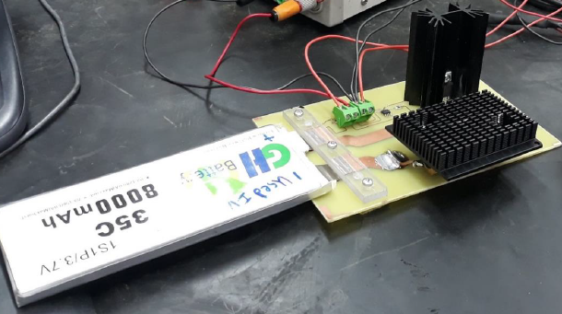
Low Voltage System
Internal Resistance PCB
Testing Process…

Slide 7
Low Voltage System
Internal Resistance PCB
Next Steps…
PCB Manufacturing
Components Soldering
ADC – DAC Programming
Testing

Slide 8


UESTIONS

Slide 9


